Slide 1
NETWORK OF INDIAN RAILWAYS
- Neil D’Souza, Nikhil Kishore, Priya Khokher, Sachin Verma

Slide 2
Largest railway network in Asia
Second largest in the world
Transports 23 million per day

Slide 3
DATA
Railway data from the open data of the Indian government
Google Maps Geocoding API

Slide 4
METHODOLOGY
Extracted unique stations.
Geocoded using Google API and used as nodes.
Already available connections as the edges
Stations of start and termination were considered.

Slide 5
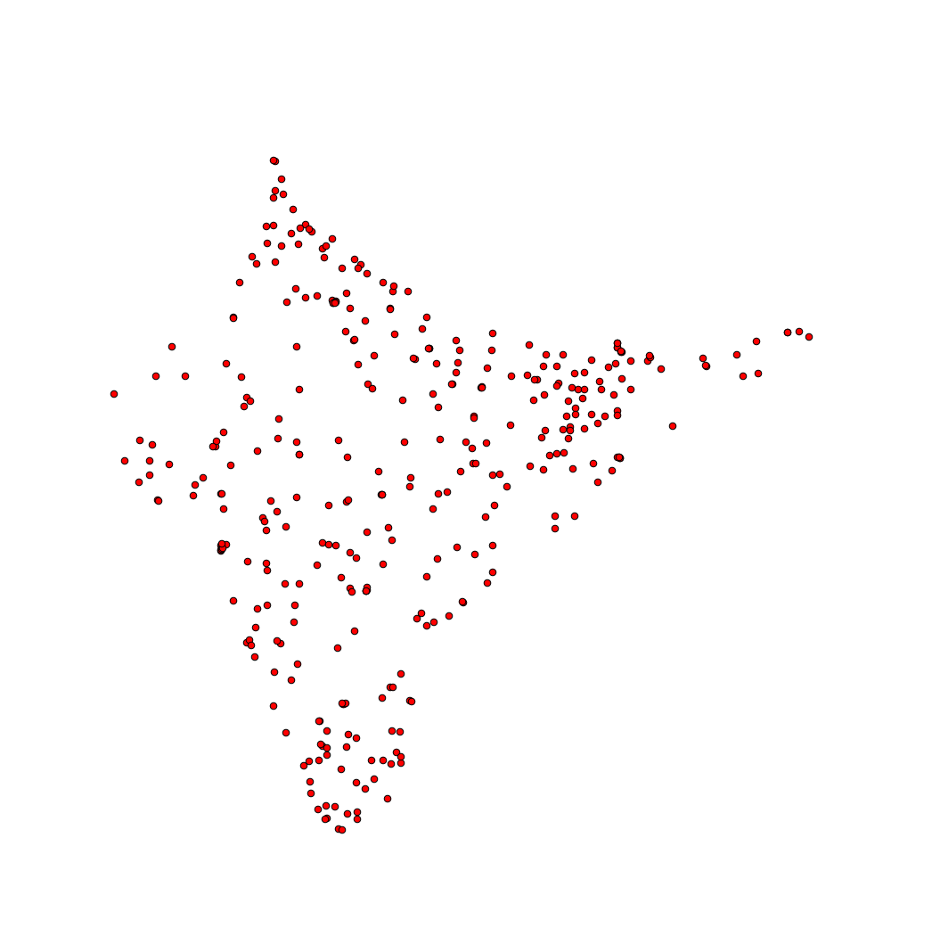
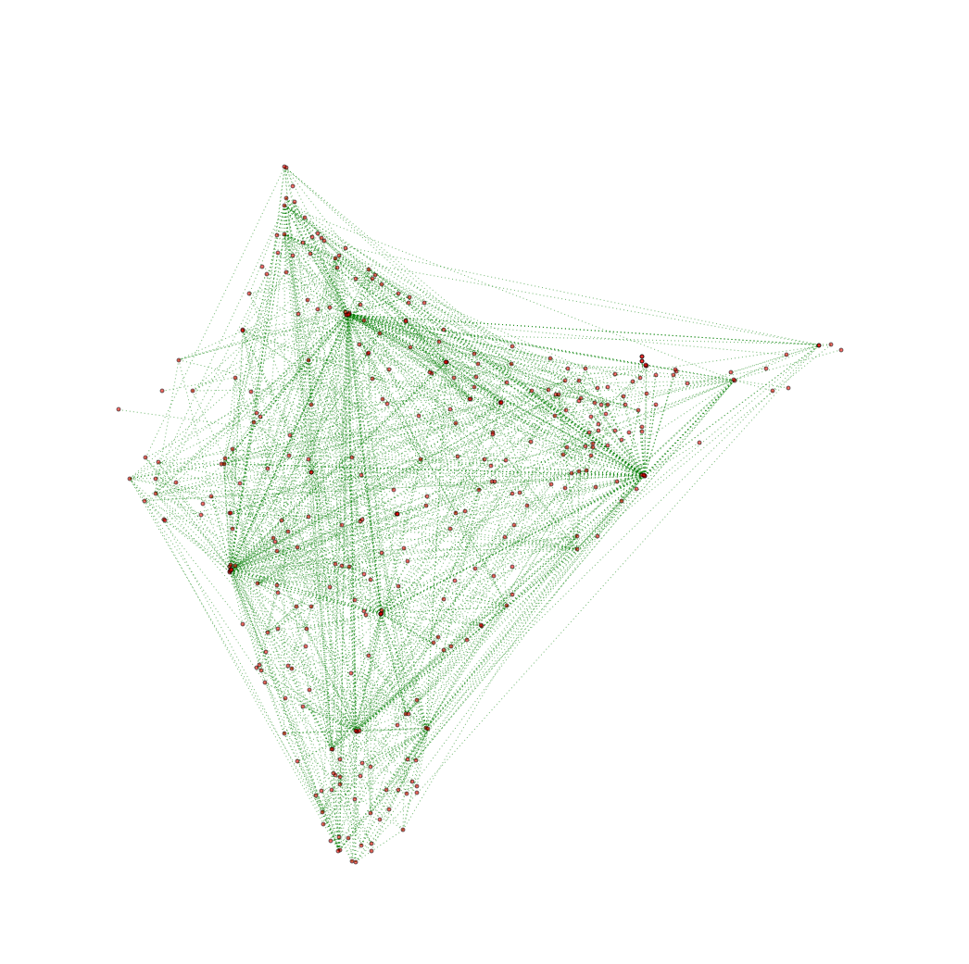
MAPS

Slide 6
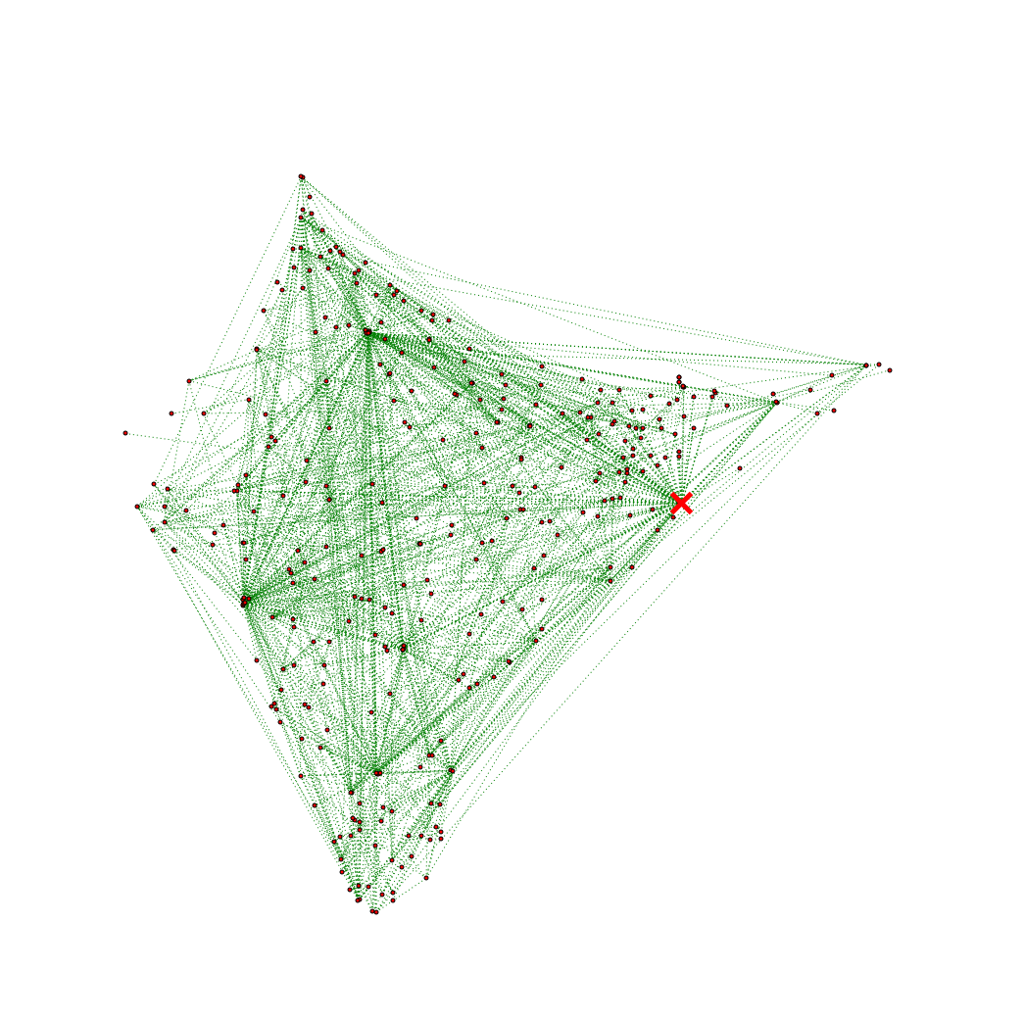
ANALYSIS
Howrah Junction in Howrah, West Bengal

Slide 7
CENTRALITIES
Degree centrality: 1|Howrah Junction - 68
2| New Delhi - 48
3|Lokmanya Tilak - 46
Eigen-vector: 1|Howrah Junction - 0.275527717266
2|Chennai Central - 0.224605874594
3|New Delhi - 0.213179694338
Betweenness: 1|Howrah Junction - 0.179544117088
2|New Delhi - 0.109405168355
3|Lokmanya Tilak - 0.10671055416
Closeness: 1|Howrah Junction - 0.472727272727
2|Chennai Central - 0.451871657754
3|Lokmanya Tilak - 0.446499339498
Pagerank: 1|Howrah Junction - 0.0278550559208
2|New Delhi - 0.0187917372527
3|Lokmanya Tilak - 0.0179238578082

Slide 8
SHORTEST PATHS
SOURCE | DESTINATION
Diva | Sawantwadiroad
Allahabadjn | Bulandshahr
Singrauli | Varanasijn
Nizamabad | Lokmanyatilakt
Kurseong | Tokurseong
Banihal | Srinagar
Mavlijn | Marwarjn
Manmadjn | Lokmanyatilakt
Removing loop edges.
Shortest path lengths of 2.

Slide 9
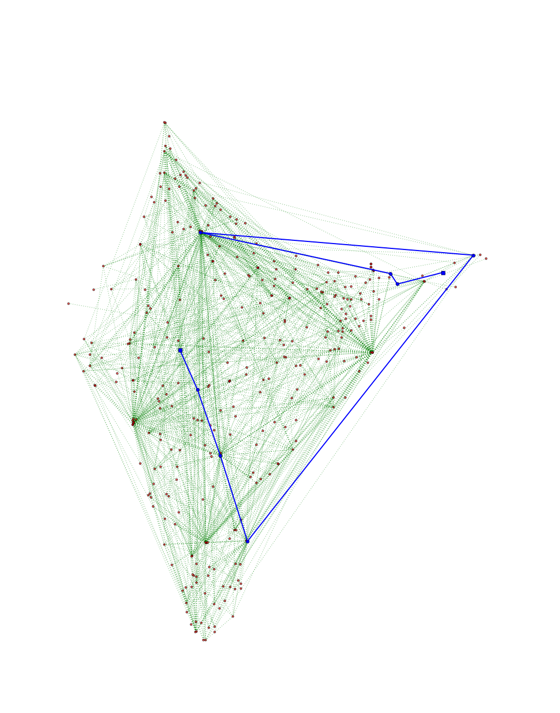
SHORTEST PATHS
Highest shortest path of 9
Indore, Akola, Kacheguda, Chennaiegmore, Dibrugarh, Delhi, Alipurduar, Dhubri and Silghat Town.

Slide 10
CONCLUSION
Howrah Junction in West Bengal holds most importance
Tie between New Delhi and Chennai Central.
New Delhi has higher degree, pagerank and betweeness centrality values.
Chennai Central has higher closeness and eigen-vector centrality values.

Slide 11
REFERENCES
“Railway connections”, https://data.gov.in/catalogs/sector/Transport-9383?query=railway&sort_by=search_api_relevance&sort_order=DESC&items_per_page=9
“Station names and coordinates”, http://www.openstreetmap.org/export#map=4/17.48/77.87
“Google Maps Geocoding API”, https://developers.google.com/maps/documentation/geocoding/intro
“Railway facts”, http://www.msn.com/en-in/travel/news/25-mind-blowing-facts-about-indian-railways/ss-AAaiOr1#image=2

